Slide 1
01
Problem

Slide 2
Problem??
Early-stage startup founders focus on increasing their customer base but miss out on how customers perceive them.
Top executives lose sight of important metrics/KPIs while working on numerous parallel engagements.
Mid-size companies have high performing individuals but lack the ability to bring them together to do extraordinary work. Are they missing something?

Slide 3

Unleash your performance through power of SaaS
/Hone - refine or perfect (something) over a period of time.
/Est - Estimate
Honest - free of deceit and untruthfulness; sincere.

Slide 4

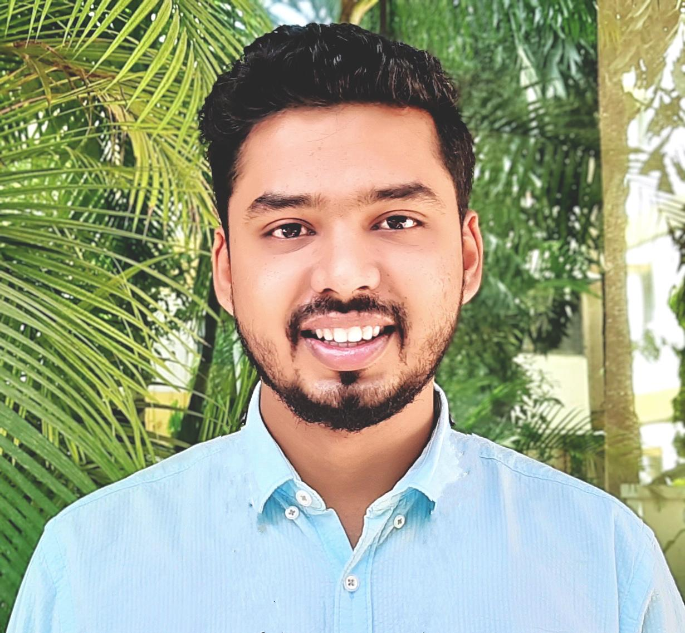

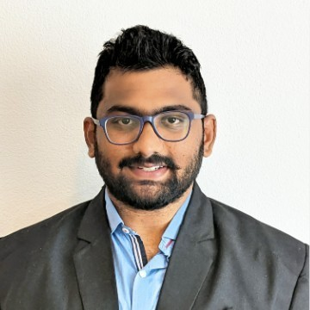
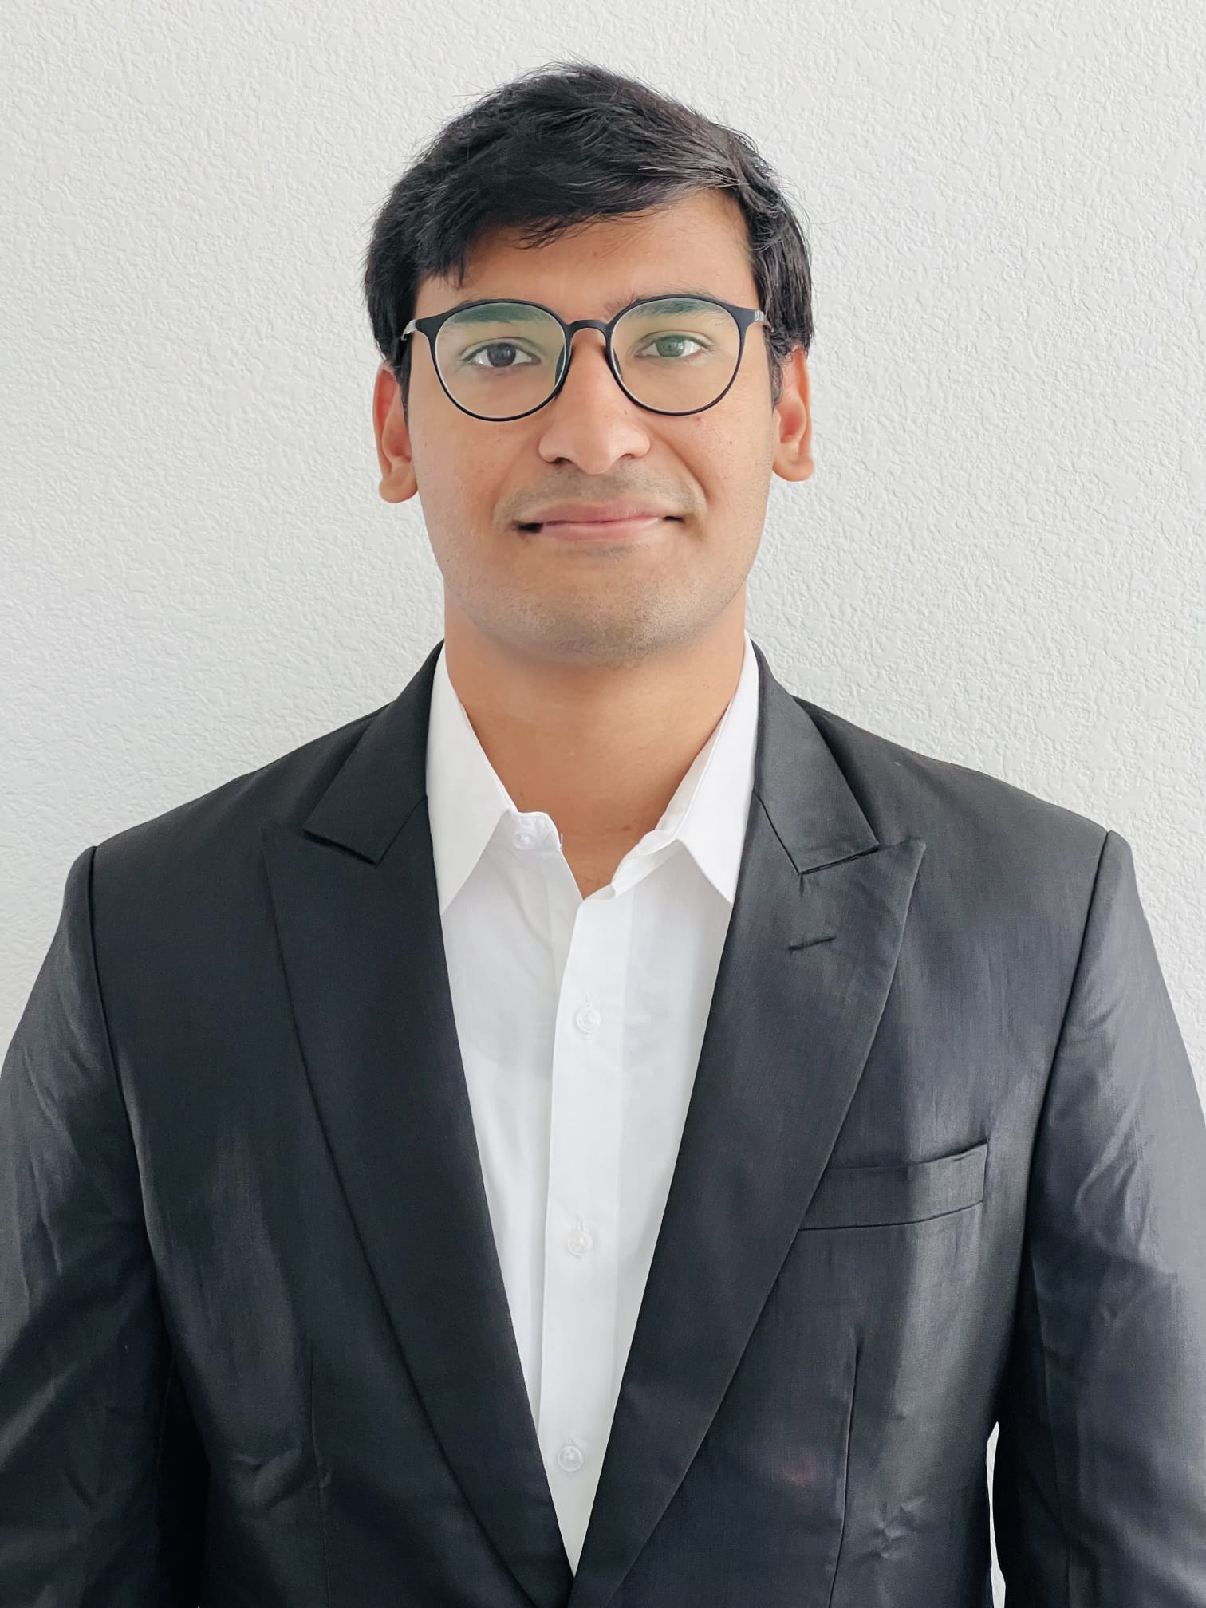
OUR TEAM
Rajesh
Customer Success
Pratik
Marketing Manager
Shweta Rawat
Engineering Manager
Umesh Reddy
Product Manager
Harsha
CEO

Slide 5
VISION
MISSION
We envision a world in which every organization is growing at an exponential rate.
To democratize the power of software so organizations can easily understand their holistic performance which enables them to scale exponentially

Slide 6
02
CUSTOMERS

Slide 7
Customer Stories
Getting the right people:
“Many Startup CTOs are not that experienced. Hire people who knows more than you.” -Jesse Teraharne, CEO of Tarot Analytics.
“It is so much faster with an experienced partner than a newbie team”- Ali Omar, Chief of Product, Project Caleido.
Understand Customer expectation:
“As the product owner/entrepreneurs, we tend to always know what ‘needs’ to be developed, or certain features that ‘must-have’. You need to listen to your team, also make sure what you want in the product is the same as what customer wants.” - John Biedermann, Founder CEO SimplyFundraisingCRM
“Wonder what your customer really want? Ask, Don’t tell.” - Lisa Stone, Cofounder CEO BlogHer.
Delivery & feedback:
“If you are working on a product that is going to be customer facing, then feedback is invaluable. You should be out there being brave, talking to people and asking for feedback as much as possible.” - Emily Brooke, Cofounder Blaze.
“Testing, testing, testing. Make sure your developers and development processes give you good unit test coverage from day one. Then make sure you have procedure to test everything else. You want to discover the bugs in your software, not customers”- Ed Ireson, Cofounder Jog.AI
Notes:
https://medium.com/profil-software-blog/7-saas-startup-software-development-challenges-why-startups-fail-4da3644b0b6

Slide 8
Early Adopters to successive buyers
Small size startups
We want to start nimble with small startups with employee strength less than 50.
They might have just launched their product and trying to acquire new customers aggressively.
Due to great resignation phase, they are also struggling to retain their employees who possess the niche knowledge and development skills to built and manage their product.
The need a standardized process and knowledge to benchmark their deliveries and also unsolicited feedbacks from their customers.
All kind of feedbacks (positive or negative) need to be analyzed to filter out the most impactful ones which to take back for development.
Mid and Big Startups, companies:
Once we gain business momentum, expertise and good customer base- we want to target mid and large organizations grappling with the issues highlighted in the challenges section.
We would offer our SasS offering as well as proven standardized framework to help organization deliver more values to their customer.
Our leading methodologies would prescribe exactly what more they can do to ensure their continued success and gain more market share that they currently have.

Slide 9
Learning from Customer Research
We researched pain points of start-ups and spoke to few and following 8 are their biggest impediments:
Fierce Competition
Winning Trust of Customers
Employee retention, engagement and productivity
Information silos across the organization impede collaboration, hamper efficiency
Efficient Marketing strategy
Partnership Decision Making
Financial Management
Unrealistic Expectations
Our product cannot solve all but we can solve the top 5 of their biggest challenges.
Notes:
Winning trust will help in Acquiring new customers and retaining current ones

Slide 10
Personas
Barry - CEO
Age: 40-50
Experience: 20+
Education: MS, MBA
Lifestyle: Busy & motivated
Goal: I want to scale my company by 10x
Challenges: Slow digital transformation and Customer retention
Values: Ambitious, Good networking, Impatient
Aman - VP
Age: 35-40
Experience: 15+
Education: MBA
Lifestyle: Passionate, Organized
Goal: Attracts more customers to increase portfolio
Challenges: Staying on top of all the projects and Retaining right talent.
Sally- SDE
Age: 20-25
Experience: 2+
Education: BSc
Lifestyle: Thrilled about innovation culture, introvert
Goal: Develop more skill set to get promoted
Challenges: Not finding enough Support from working environment, forced to work on repetitive modules.

Slide 11
Customer Journey
Awareness
Consideration
Purchase
On boarding
Advocacy
Awareness:
Customer searches for an answer to a problem and becomes aware of our organization and our
products or services.
Consideration:
Customer weighs our offerings
that could solve their problem.
Purchase:
Customer decides and purchases our Product.
Website: Explore plans and Start using community for free
Retention: Our organization’s
Sales team keep the customer engaged through Steering committee meetings, continuous improvement opportunity initiative, phone calls.
Consideration:
Customer weighs our offerings that could solve their problem.

Slide 12
03
Solution &
Feature Introduction

Slide 13
Feature Intro and Solution
Customer Happiness Index - Assess the customers and how they are perceiving about company brand and its solutions. Based on that, we provide customer happiness index score and suggestions to improve it.
Employee Alignment - Align individual's achievements with the organisation’s success.
Project Metrics - Integrating with third party apps to provide bird's-eye view of your project’s insights.

Slide 14
How customer life is improved
Customer Happiness Index:
Getting keen insights on how the customers view them as a brand.
Helps companies understand the expectations of customers in a more effective way and work out those areas where they are lacking.
Employee Alignment :
Employees have better understanding on their individual responsibilities, skills and talent according to company's expectation
Leaders can manage their teams and team members in a more effective way.
Project Metrics:
Top executives have ease in accessing and understanding success metrics of various product / project in a single portal and how the company is doing as a whole.

Slide 15
04
Market Research

Slide 16
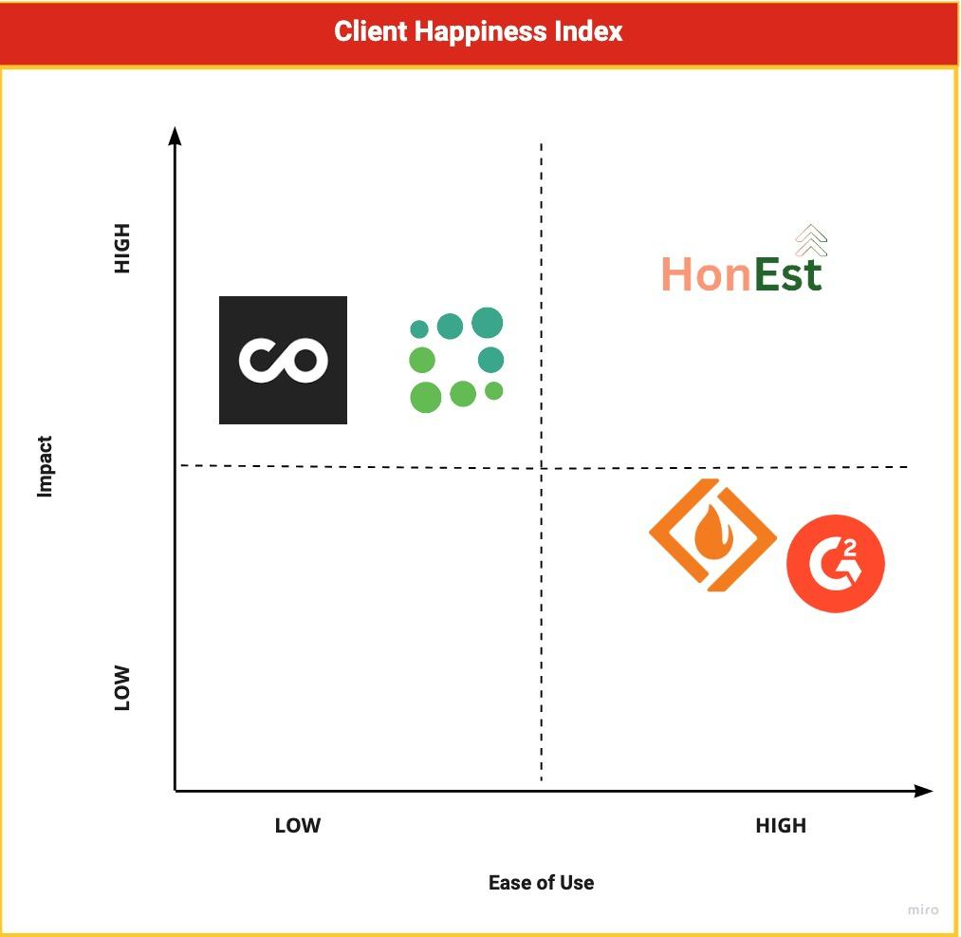
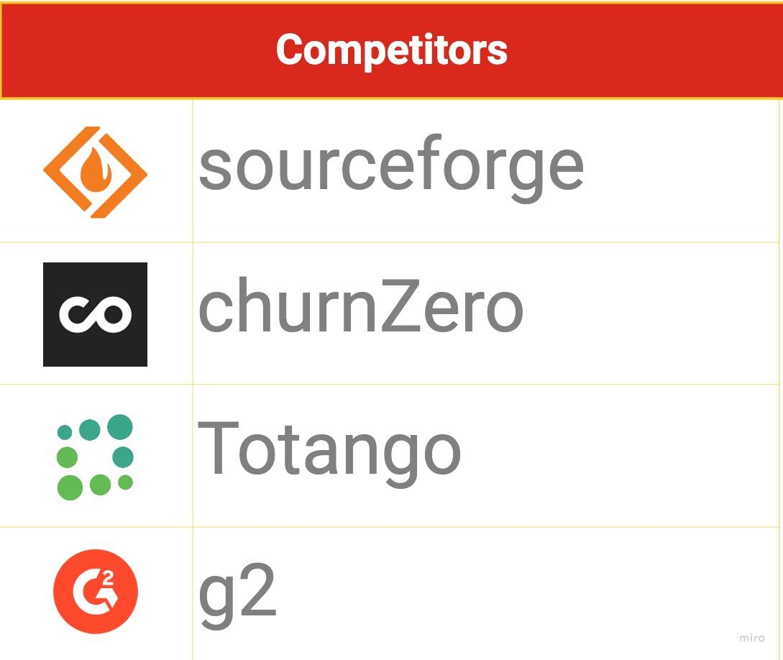
Competitor Matrix - Client Happiness Index

Slide 17
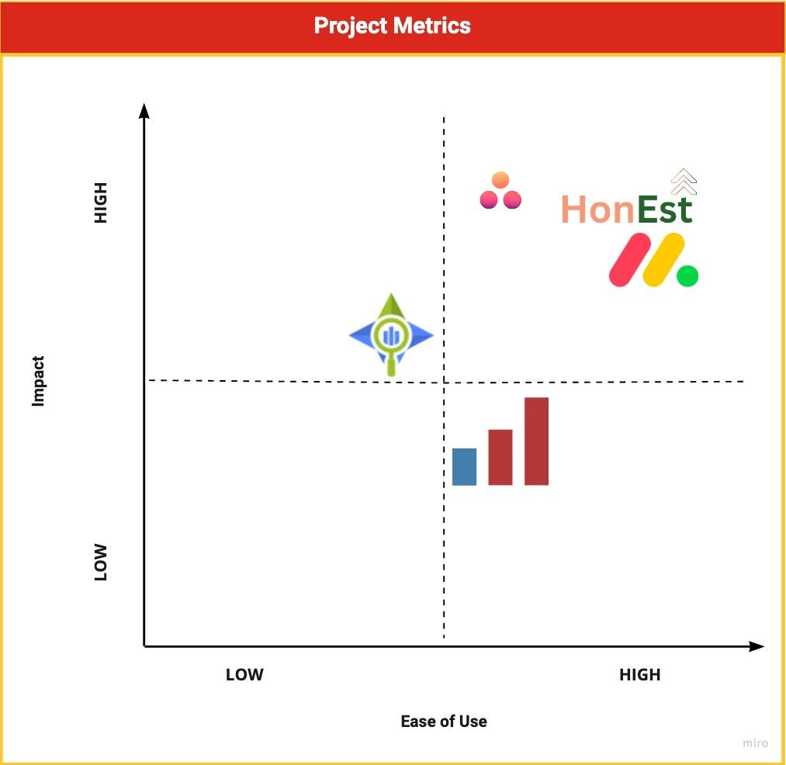
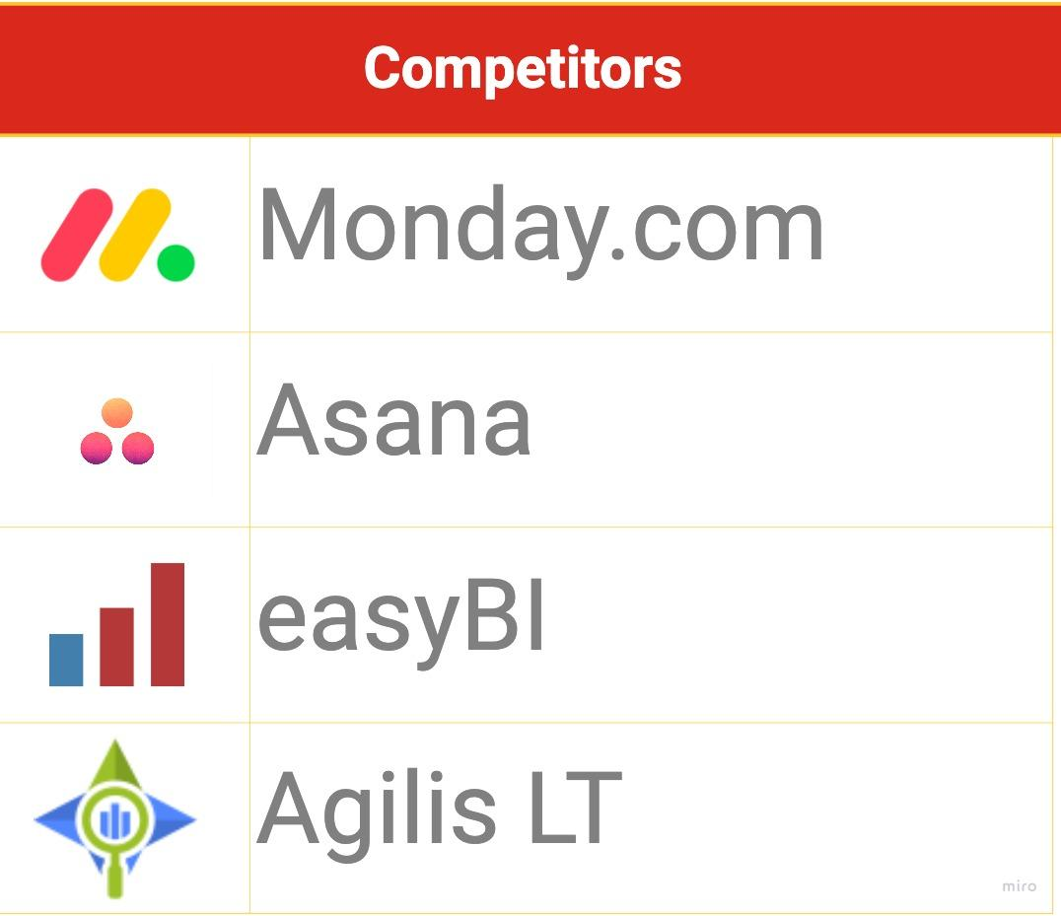
Competitor Matrix - Project Metrics

Slide 18
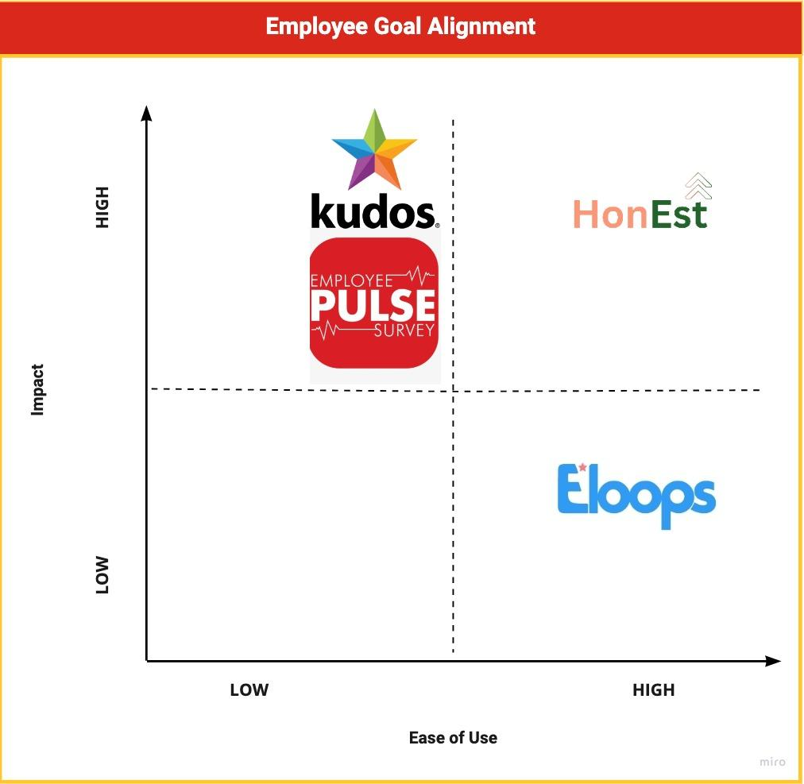
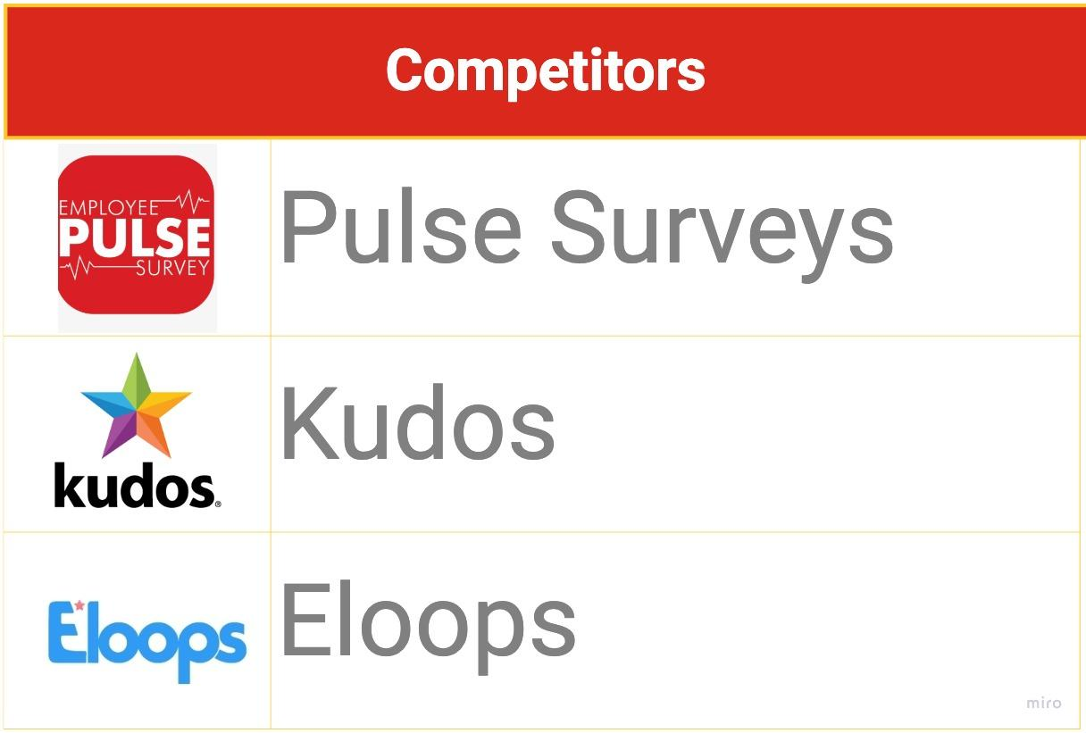
Competitor Matrix - Employee Alignment

Slide 19
Differentiator
Offer Suggestions with analysis on CHI
Tracking of these suggestions
Personal Growth Plans for each employee based on EHI
Integrate everything in place
Provide a 360 Degree View

Slide 20
05
Product

Slide 21
Positioning
HonEst offers unique value proposition to the small and mid-size companies to accelerate their growth. HonEst assesses company and create a 360 degree view of it’s offerings- from customer to deliveries, from employees to projects. Keeping automation at our heart, HonEst fast forward your company success goals by evaluating your company through numerous industry benchmarks. With the help of our thought leadership and scientific methods- we provide you actionable insights to improve. HonEst is the path to become better you, for tomorrow.

Slide 22
Pricing
Community
Great for company in early stages
Features
Basic Customer Happiness Index
Starter
Great for company in post early startup stage
Features
Customer Happiness Index
Projects Metrics
Growth
Great for Mid Size companies
Features
Customer Happiness Index
Happiness Index
Project Metrics
Free for 1 Month
$1000/mo
Custom Quote

Slide 23
06
Roadmap

Slide 24
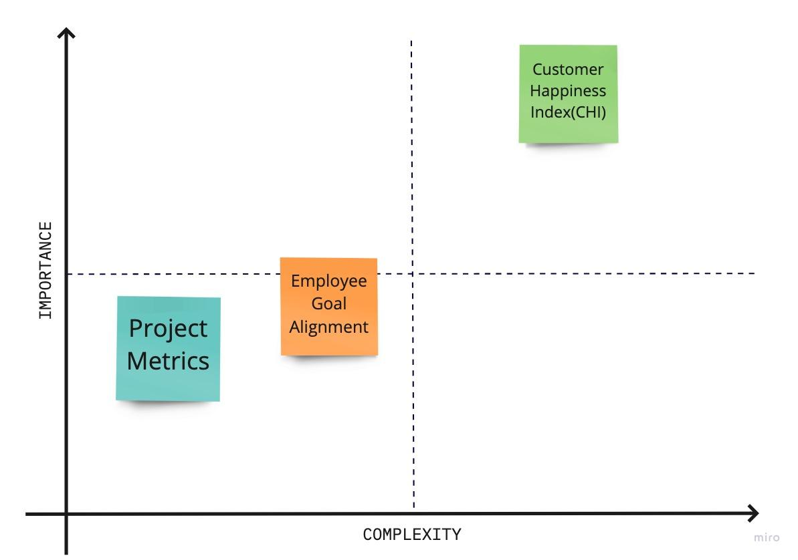
Feature Prioritization Matrix

Slide 25
Roadmap
Community Plan Feature
Holistic Scorecard
Enterprise Feature
Customer Happiness Index Feature
Finance Goal Track
Third Party Integration (Jira)
Project Metrics
Build Website
Analytical and SEO
Employee
l Alignment
Build an ML team
Signup with Jira
Beta for Employee Feature
Beta for Enterprise Feature
Early Adopters
Launch
Jan’23
Mar’23
Apr’23
June’23
Sept’23
Dec’’23

Slide 26
Thank You

